Slide 1
Psalm 19
The Perfect God
Declared GLORY and HANDIWORK
Creation’s Witness of God
God’s Word Reveals Results
Notes:
Greatness and the Wonder of our God! Inscribe the loving heart on the tree with the initials of the lovers!

Slide 2
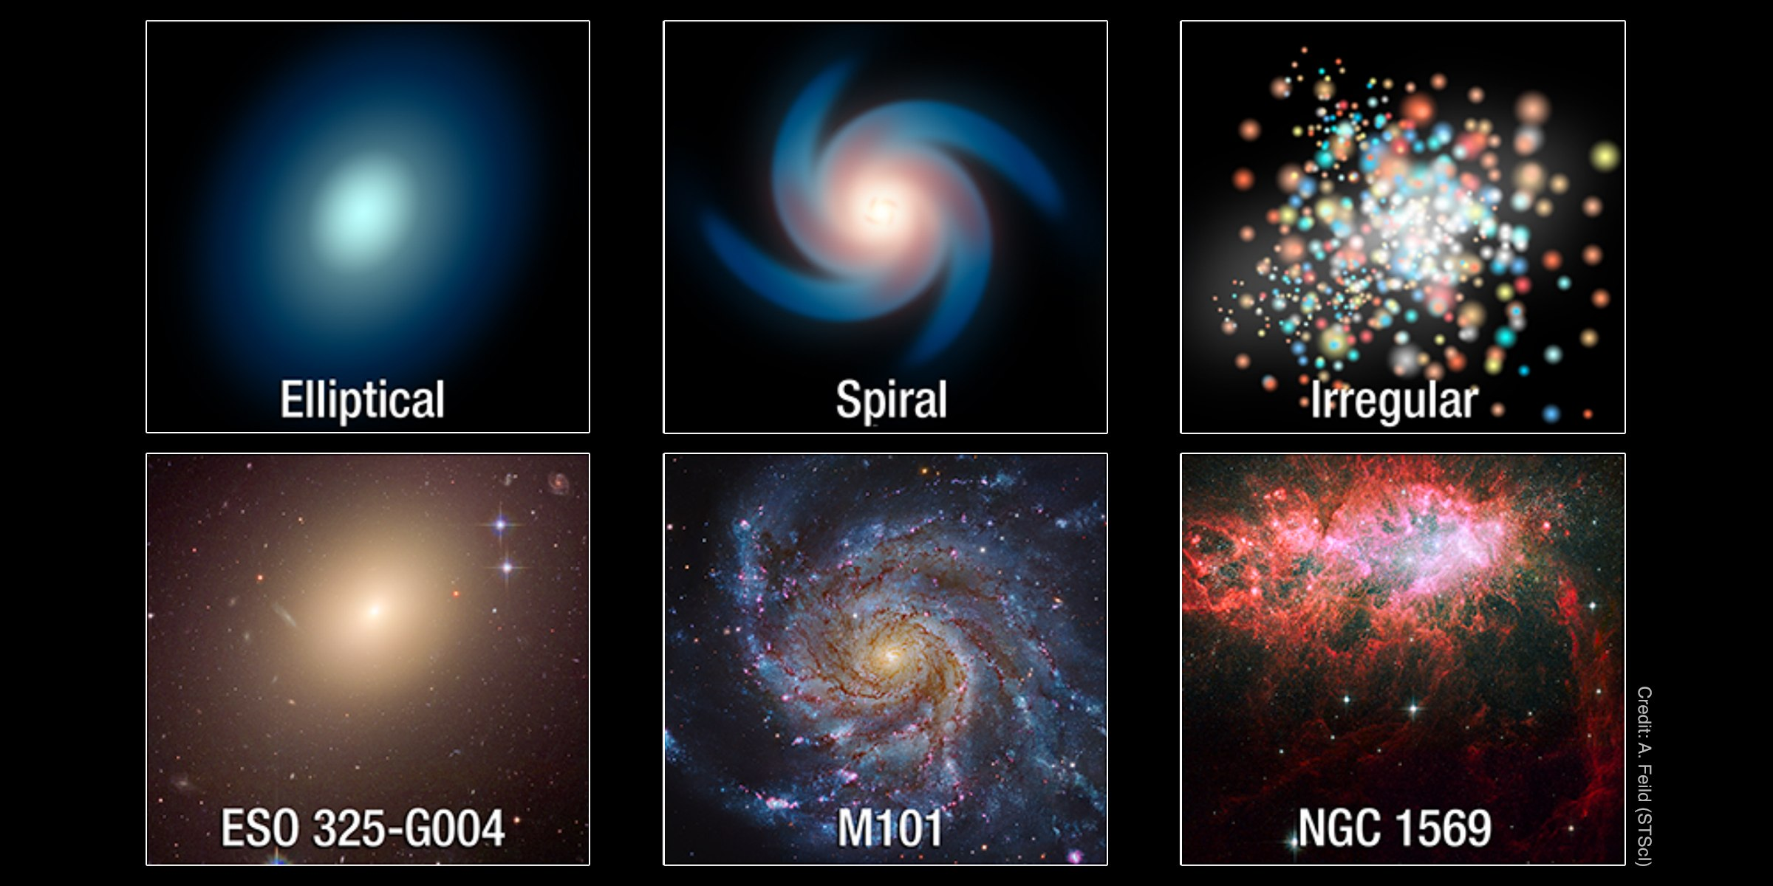
The Heavens declare the glory of God
Notes:
Add God’s design and variation shows ability to be artistic in every way!

Slide 3
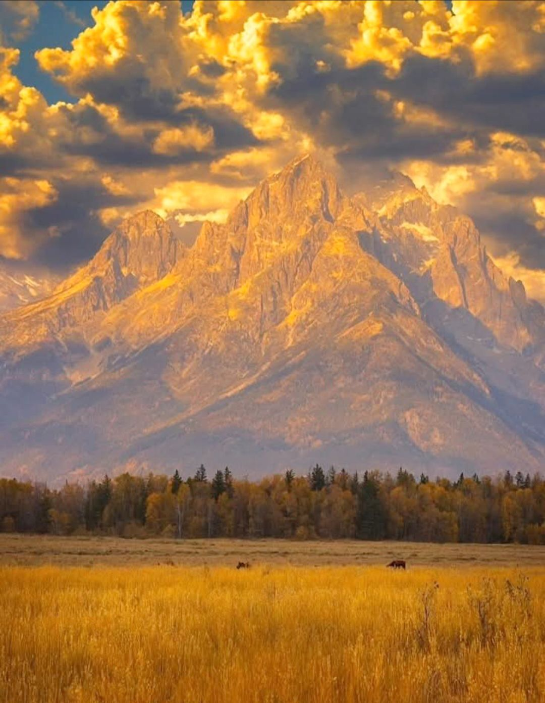
The firmament shows His handiwork
For the invisible things of him from the creation of the world are clearly seen, being understood by the things that are made, even his eternal power and Godhead; so that they are without excuse: Rom 1:20
Notes:
Grand Tetons reaching into the firmament

Slide 4
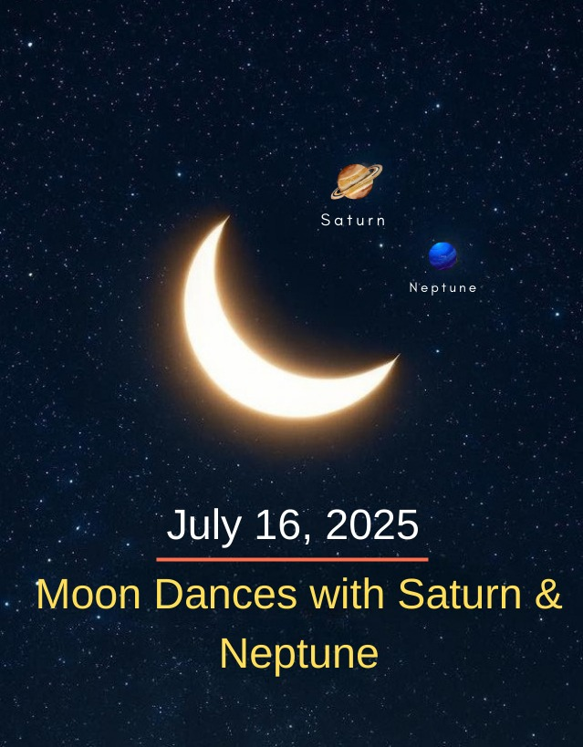
Day unto day utters speech, and night unto night shows knowledge.
Psa 89:36 His seed shall endure for ever, and his throne as the sun before me.
Psa 89:37 It shall be established for ever as the moon, and as a faithful witness in heaven. Selah.
Notes:
Davidic covenant as an oath from God will be accomplished! Emphasis on patterns, language sounds and descriptive marks to show ideas, thoughts and expressions!

Slide 5
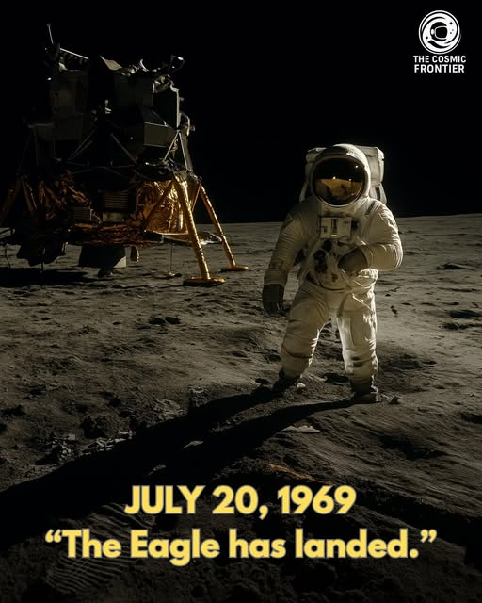
There is no speech nor language where their voice is not heard.
Who (Christ) is the image of the invisible God, the firstborn of every creature:
For by him were all things created, that are in heaven, and that are in earth, visible and invisible, whether they be thrones, or dominions, or principalities, or powers: all things were created by him, and for him:
And he is before all things, and by him all things consist.
Col. 1:15-17
Notes:
Verse 3; A universal language for all to see and hear! Some people still miss out?

Slide 6
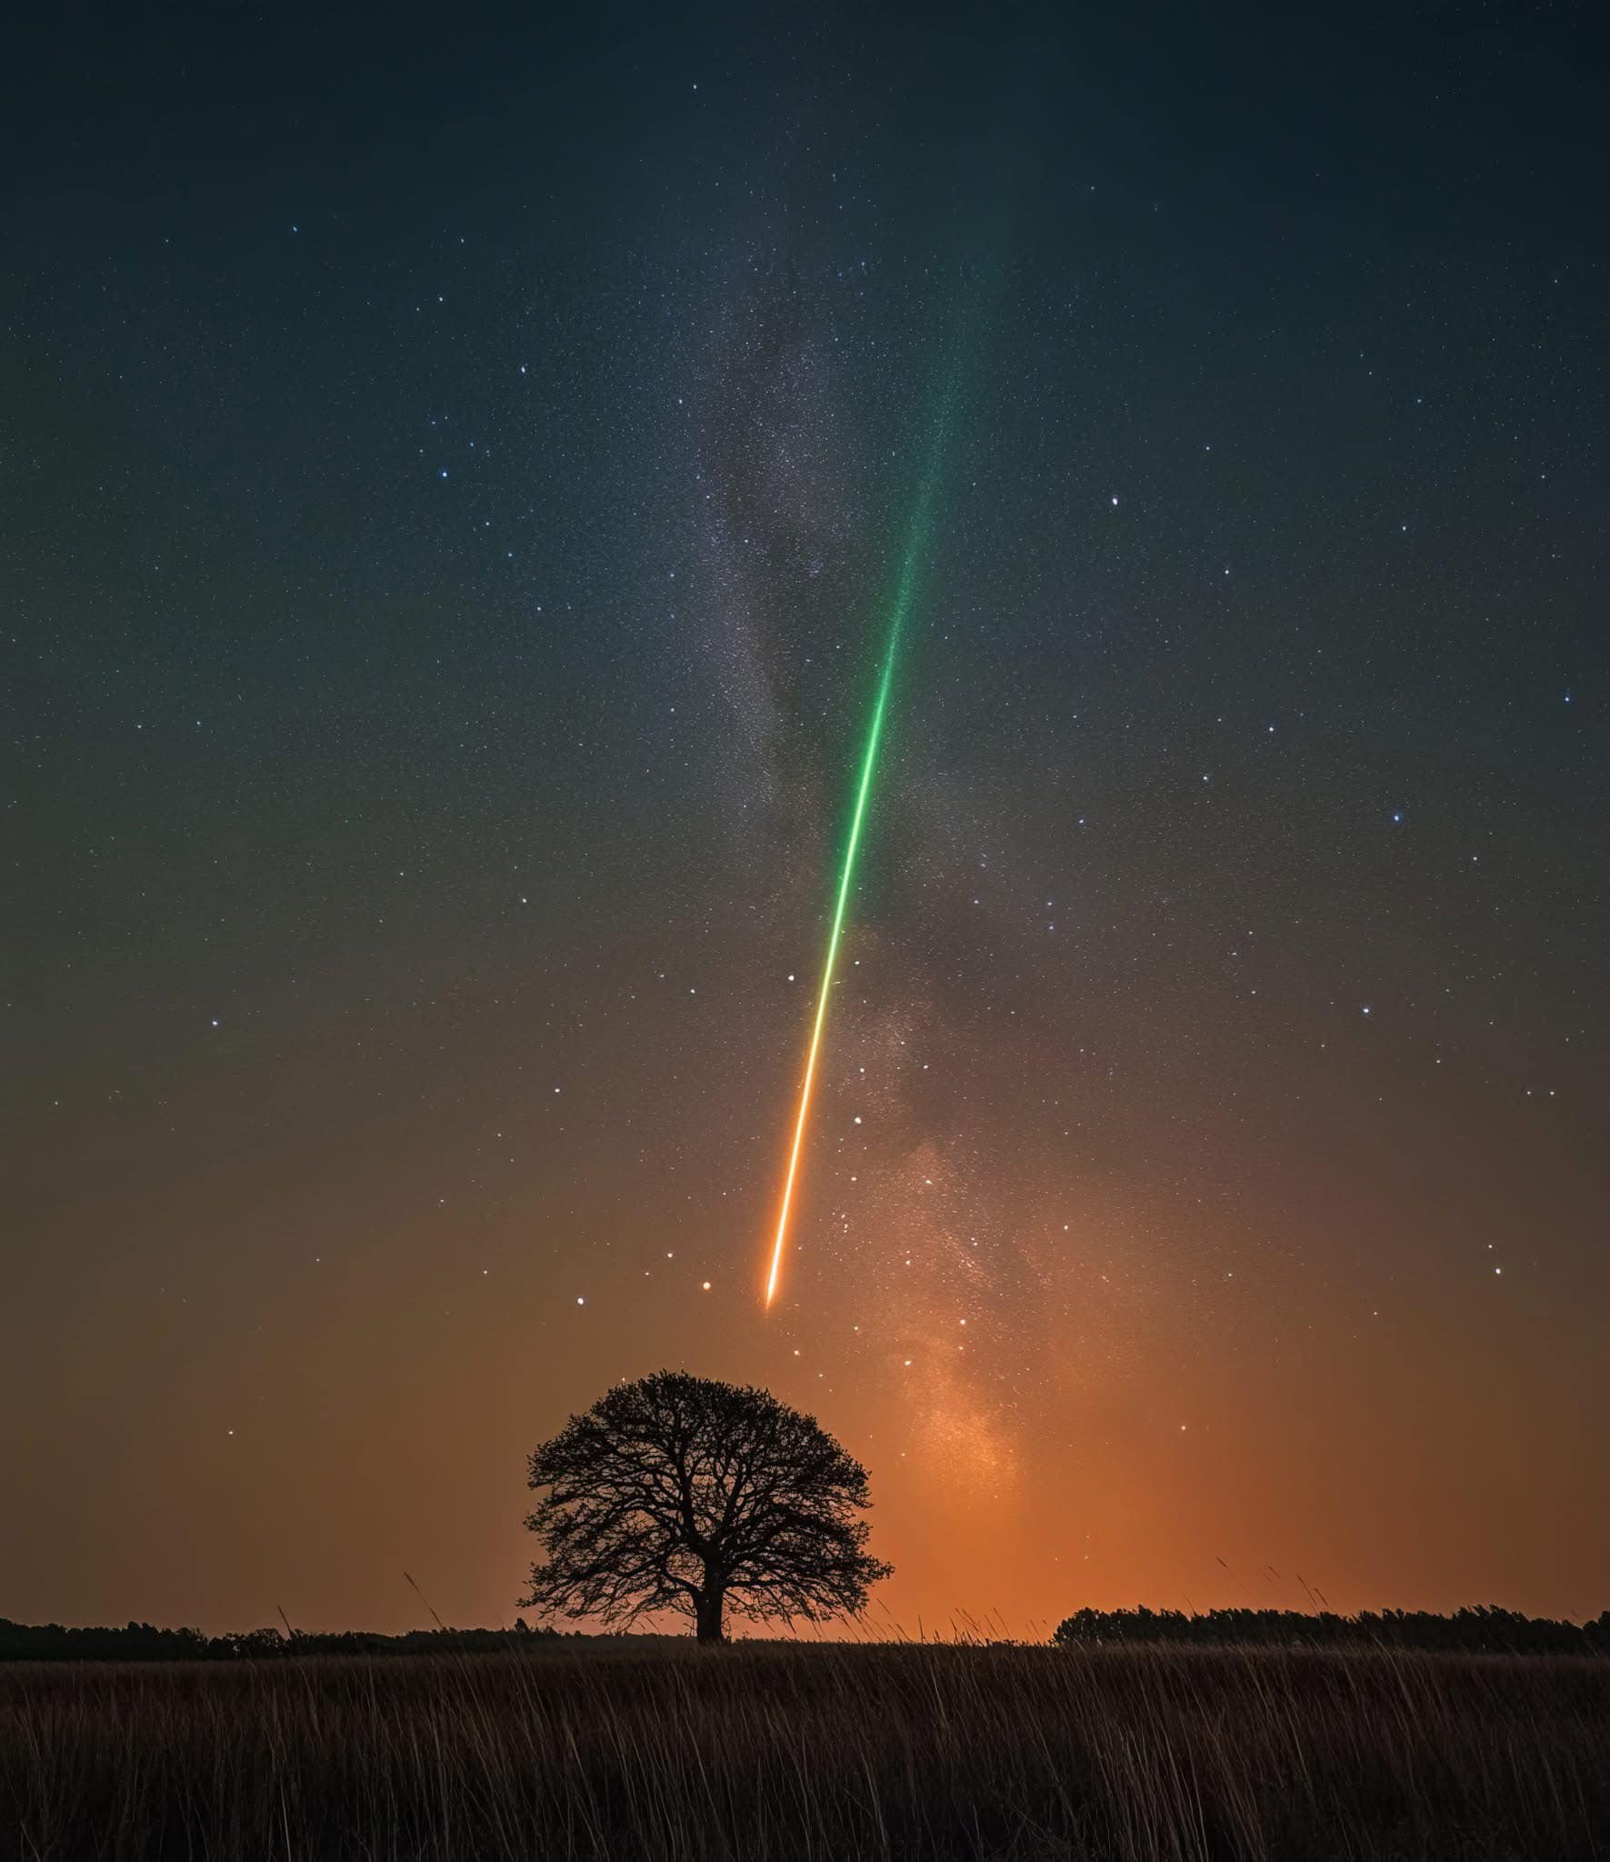
Their line has gone out through all the earth, and their words to the end of the world.
Hath in these last days spoken unto us by his Son, whom he hath appointed heir of all things, by whom also he made the worlds;
Who being the brightness of his glory, and the express image of his person, and upholding all things by the word of his power, when he had by himself purged our sins, sat down on the right hand of the Majesty on high;
Notes:
19:4, Hebrews 1:2-3; God speaks! Our own galaxy, the milky way, and an interrupting meteor.

Slide 7

In them He has set a tabernacle for the sun,
Which is as a bridegroom coming out of his chamber, and rejoiceth as a strong man to run a race.
His going forth is from the end of the heaven, and his circuit unto the ends of it: and there is nothing hid from the heat thereof. Psalm 19:5-6
Notes:
Verse 4b, 5-6 Perspective: God’s, man’s, on the moon? Or out in space! Solomon spoke of the futility of man to make a temple for God!

Slide 8
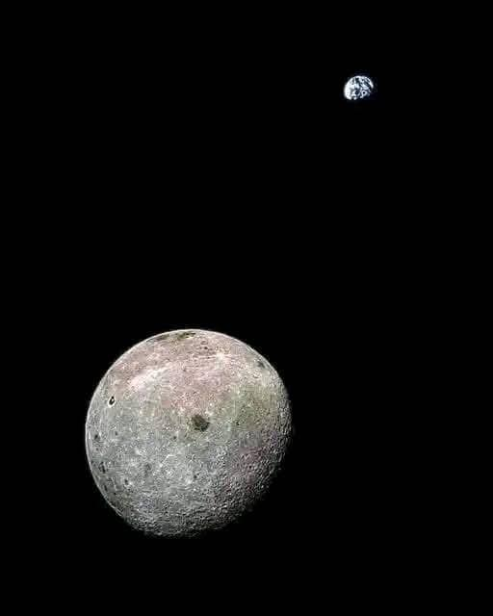
Man’s Perspective, a bridegroom, a circuit and the heat of the sun.
Because that, when they knew God, they glorified him not as God, neither were thankful; but became vain in their imaginations, and their foolish heart was darkened.
Rom 1:22 Professing themselves to be wise, they became fools,
Notes:
Far side of the moon with earth in the background! Man’s perspective is a little off from what God sees! Man would give glory only as far as the sun, worship only nature.

Slide 9

The Revelation of God in His Word! The whole Word gives us the will of God.
Romans 2:13-16;
Which shew the work of the law written in their hearts, their conscience also bearing witness, and their thoughts the mean while accusing or else excusing one another;)
Rom 2:16 In the day when God shall judge the secrets of men by Jesus Christ according to my gospel.
Notes:
2nd Theme: Revelation of “God is Good!” Being converted or born again by the word of God. The natural man cannot do this!

Slide 10
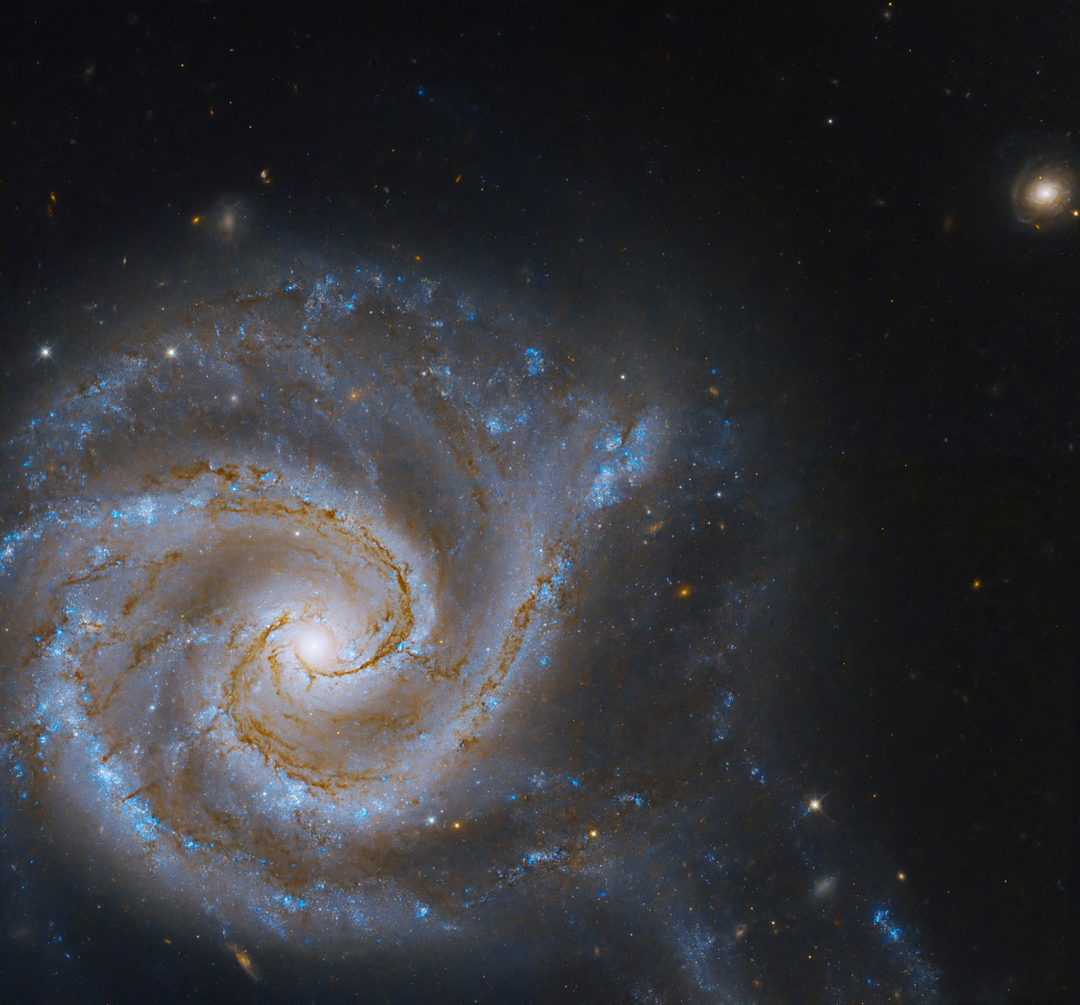
The law of the LORD is perfect, converting the soul;
To whom then will ye liken me, or shall I be equal? saith the Holy One.
Isa 40:26 Lift up your eyes on high, and behold who hath created these things, that bringeth out their host by number: he calleth them all by names by the greatness of his might, for that he is strong in power; not one faileth.
Notes:
A271, The Spiral twin galaxy; Isaiah 40:25-26.

Slide 11
Describe the Converted Soul? THE LORD
the testimony of the LORD is sure, making wise the simple.
Psa 19:8 The statutes of the LORD are right, rejoicing the heart: the commandment of the LORD is pure, enlightening the eyes.
Psa 19:9 The fear of the LORD is clean, enduring for ever: the judgments of the LORD are true and righteous altogether.
SURE: Simple is made wise.
RIGHT: Heart is made to rejoice.
PURE: Eyes enlightened.
CLEAN: Enduring forever.
TRUE: Absolute truth
RIGHTEOUS: Concept of Holy
ALTOGETHER: United, in Union

Slide 12
Encouraged into motivation and action
Psa 19:10 More to be desired are they than gold, yea, than much fine gold: sweeter also than honey and the honeycomb.
Psa 19:11 Moreover by them is thy servant warned: and in keeping of them there is great reward.
Gold Rush of 1849 in CA drove thousands to the hills of California looking for gold. The desire can be stronger to be in the Word of God.
The process can be sweet.
True weather? Warnings heed!
The reward is out of this world! Eternal life is with the Lord Jesus Christ at His place!
Notes:
The relationship as one who is a son of God, the Father, whose great love gives life, purpose and rewards.

Slide 13
We are people, guilty, wondering, and issues of errors,faults, and sins
Psa 19:12, Who can understand his errors? cleanse thou me from secret faults.
Psa 19:13 Keep back thy servant also from presumptuous sins; let them not have dominion over me: then shall I be upright, and I shall be innocent from the great transgression.
Rom 3:21 But now the righteousness of God without the law is manifested, being witnessed by the law and the prophets;
Rom 3:22 Even the righteousness of God which is by faith of Jesus Christ unto all and upon all them that believe: for there is no difference:
Notes:
Believing in the faith! All have sinned! So, all can be justified by believing

Slide 14
So, all can be justified by believing!
Romans 3:23-26
Jesus on the CROSS!
Justified freely by grace
Redemption in Christ Jesus
Propitiation by Christ Jesus blood
Remission of sins past, present and future!
1Peter 1:23 Being born again, not of corruptible seed, but of incorruptible, by the word of God, which liveth and abideth for ever.
For all have sinned, and come short of the glory of God; Being justified freely by his grace through the redemption that is in Christ Jesus: Whom God hath set forth to be a propitiation through faith in his blood, to declare his righteousness for the remission of sins that are past, through the forbearance of God; To declare, I say, at this time his righteousness: that he might be just, and the justifier of him which believeth in Jesus.
Notes:
Romans 8 tells of the indwelling Holy Spirit of God and the life of victory Jesus has in us!
Peter tells us of the new life in Jesus Christ!

Slide 15
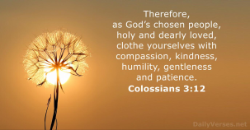
My Words and Meditation Acceptable to the LORD God, my Strength & my Redeemer.
Rom 11:33 O the depth of the riches both of the wisdom and knowledge of God! how unsearchable are his judgments, and his ways past finding out!
Rom 11:36 For of him, and through him, and to him, are all things: to whom be glory for ever. Amen.

